Slide 1
How work
output device and
input device
with computer?

Slide 2
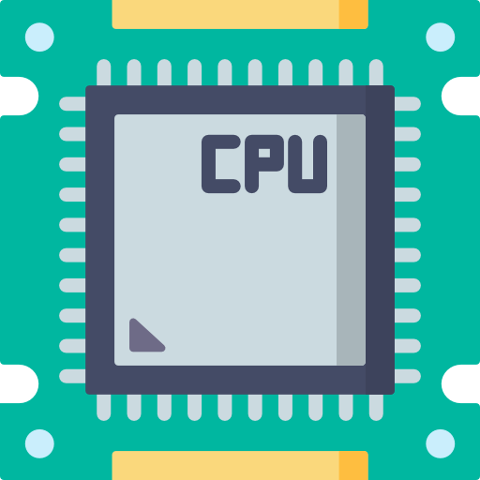
What is the device?
Set of mechanisms and components that, connect to a computer, are able to send commands from a external source, to transfer data, process and present the information through other device, etc.

Slide 3
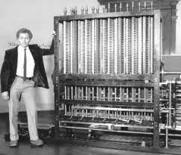
History about input/output device
Babage's calculating machine

Slide 4
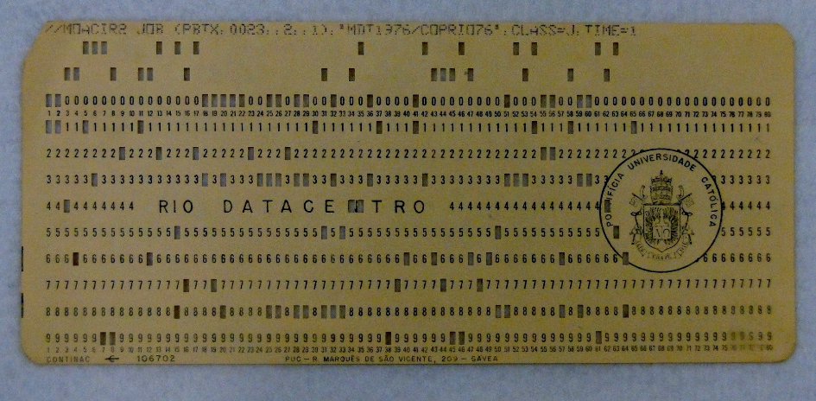
History about input/output device
The punched card is considered the first input and output device of a computer

Slide 5
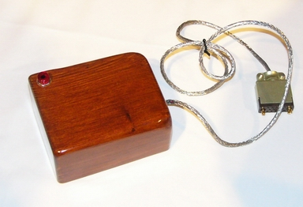
History about input/output device
created in 1963 by researcher Douglas Engelbart
from the Stanford Research Institute.

Slide 6
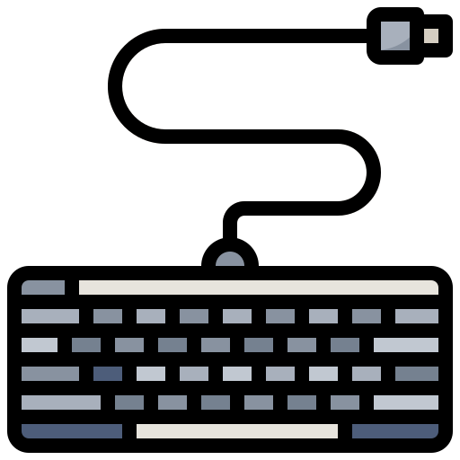
What is the “Input Device”
An input device is any hardware device that sends data to a computer, allowing you to interact with and control it.
The most commonly used or primary input devices on a computer are the keyboard and mouse. However, there are other devices that input data into a computer.

Slide 7





What are the different types of
“Input Devices” ?

Slide 8


How does input device work with computer?
Notes:
As Ron explained, there are many different kind of input devices nowadays.
But how does input device work with computer? How does computer input and understand from another devices?
Let’s take a look.

Slide 9
How does input device work with computer?
The input devices allow the users to send signals to the computer to perform a certain task.
The Central Processing Unit (CPU) reads data from memory and writes the result to memory again.
The CPU sends the signal to the output devices.
Notes:
(Read sentences on slide)
so computer is received signals from input device, and CPU reads data and rewrite, and sends the signal to the outputdevice.
That’s a way it works.
But, how does input device send signals to CPU, and how does CPU understand?
For instance, keyboard.

Slide 10
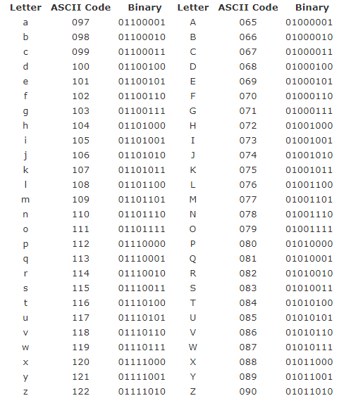
How does input device work with computer?
Computers don't understand languages directly, so they need to be translated to a form that is easier understood.
That form is called machine language or binary.
Let’s check it out
https://cryptii.com/pipes/binary-decoder
Notes:
When you type alphabet on keyboard, computer translates alphabet into a programming language.
(Read sentences on slide)
(Jump to link)
As you can see, computers use a programming language.
This sentence includes all of A to Z.

Slide 11
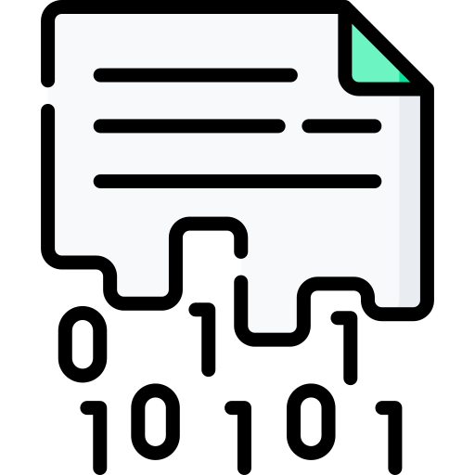
How does input device work with computer?
The task is to gather data to be processed bythe computer sometimes called raw data and convert it into some form the computer can understand!
Notes:
(Read sentences on slide)

Slide 12

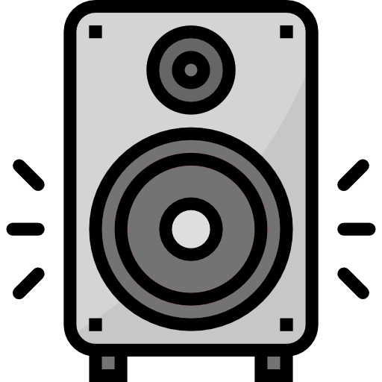
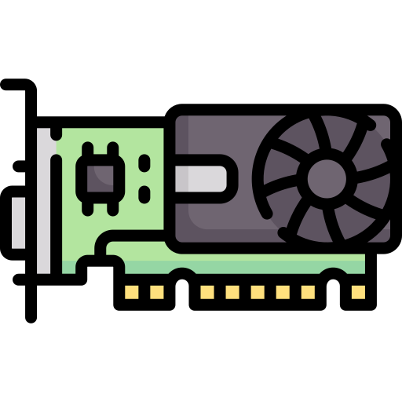
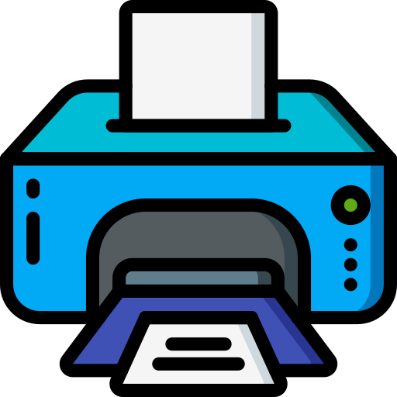
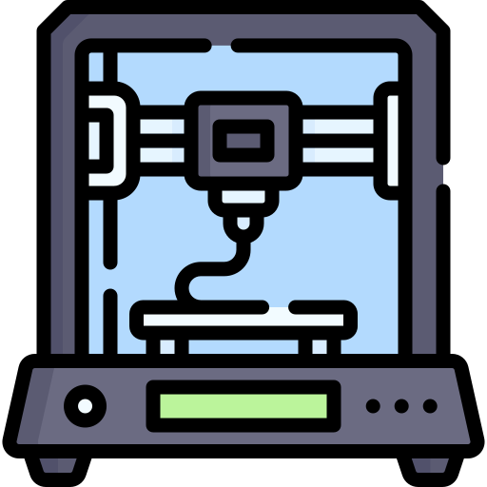
What is the “Output Device”
Notes:
[Hana]
An output device receives data from a computer, usually for display, projection, or physical reproduction. Monitors and printers are two of the most commonly used output devices used with a computer.
Let's get checked other output devices.

Slide 13
Type of Output Device
●Soft-copy output : text file, imagis, video
●Hard-copy output : printed object
Notes:
[Hana]
A soft copy could be text files, images and videos. A hard copy is defined as a physical object like a printed document . A digital version of a document or file is a soft copy of that document.

Slide 14
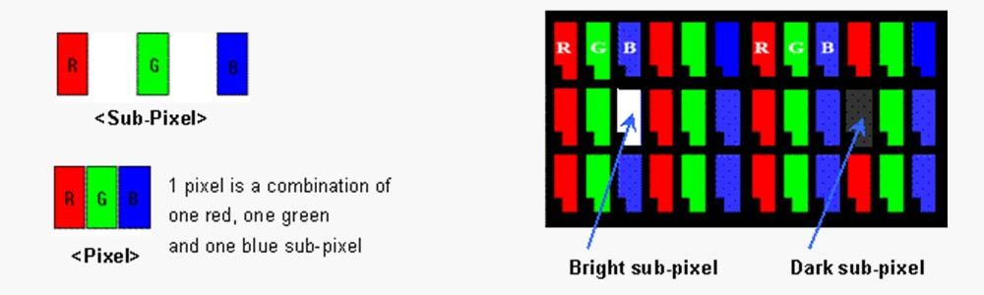
Monitor
Notes:
[Hana]
Monitors are the most popular soft-copy output devices and main output device of a computer.
It forms images from tiny dots, called pixels.
The sharpness of the image depends on the number of pixels.

Slide 15
Printers
●Impact Printers - Dot Matrix Printer
- Daisy Wheel Printer
- Drum Printer
- Chain / Band Printe
●Non-Impact Printer - Inkjet Printer
- Laser Printer
- Thermal Printer
Notes:
[Hana]
Printers are the most popular hard copy output devices. There are two types of printers: impact printers work by direct contact of an ink ribbon with paper. like a typewriter.
non-impact printers print without using hit or impact a ribbon to print
These days non impact printer is more popular than impact printer.

Slide 16
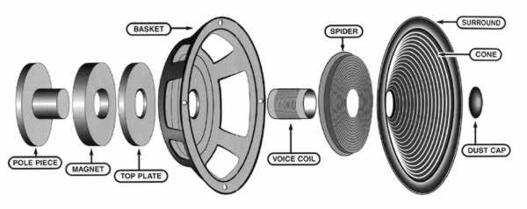
Speaker
Notes:
[Hana]
A speaker is a device that outputs sound by converting electrical signals into sound.
When an electric current flows through the voice coil, it reacts with the surrounding magnets to create vibrations.
This vibrates the cone, which in turn vibrates the air, producing sound.

Slide 17
How does output device work with computer?

Slide 18
How does output device work with computer?
Notes:
An output device works by receiving signals from the computer and using those signals to perform tasks to display the output.

Slide 19

How does output device work with computer?
An output device works by receiving signals from the computer and using those signals to perform tasks to display the output.
Notes:
An output device works by receiving signals from the computer and using those signals to perform tasks to display the output.

Slide 20



How does output device work with computer?
Notes:
1.On a computer keyboard (input device), if you type "W", it sends (inputs) a signal to the computer.
2.The computer processes the input and once completed, sends a signal to a monitor (output device).
3.The monitor receives the signal and displays (outputs) the "W" to the screen.
4.If supported, that "W" could also be printed (outputed) to a printer, which is another example of an output device.

Slide 21
Summary
Input device
Hardware devices that send data to a computer such as the keyboard and mouse
Need to convert physical signals to electrical signals
Notes:
A soft copy could be text files, images and videos. A hard copy is defined as a physical object like a printed document . A digital version of a document or file is a soft copy of that document.

Slide 22
Summary
Output device
Hardware devices that receive data from a computer such as the monitor and printer
Need to convert electrical signals to physical signals
Notes:
A soft copy could be text files, images and videos. A hard copy is defined as a physical object like a printed document . A digital version of a document or file is a soft copy of that document.

Slide 23
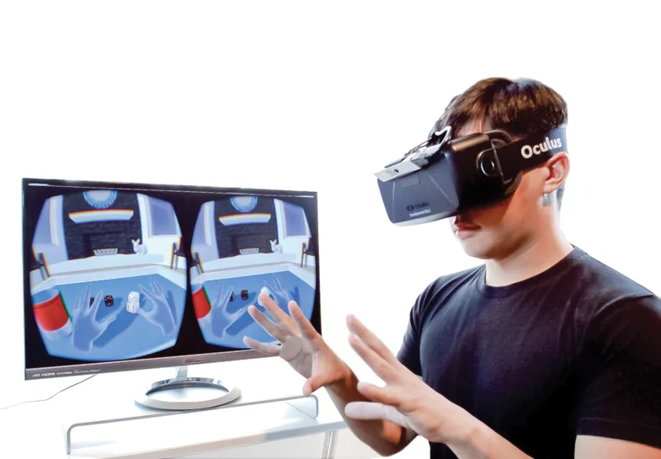
Future expectation
After VR and AR are more developed...
Notes:
A soft copy could be text files, images and videos. A hard copy is defined as a physical object like a printed document . A digital version of a document or file is a soft copy of that document.

Slide 24
Thank you!
Group3 : Paulo, Yuya, Atena, Kazuki, Hana, Ron

